Slide 1
Welcomes to Today’s
Agency View-Point NFJP Users Forum
WIOA Collaboration Webinar

Slide 2
Today’s Topics
Who is a Participant and who is a Reportable Individual
Determining the “Date of Participation” and how to configure AVP correctly
Determining the “Date of First Related Assistance Service” and how to configure AVP correctly
How to Calculate Section B.5(Reportable Individuals) in the QNR(WIOA Plan vs Actual)
Issues with a Plan created without knowing that RA-Onlys will never be participants and suggested methods of correcting the plan.
Korene Gonzalez, Community Council of Idaho
Export PIRL waits 6 months to report follow up data.
Export PIRL does not report Date of Program Entry (900) and Date of Program Exit(901) in PIRL Record
MSG – Element 1811 is used for the dividend for MSG performance calculations.
Progress towards submitting the reports due for 1st quarter, PY 2017.

Slide 3
Who is a Participant and who is a Reportable Individual .
We probably will not have guidance, so we will need to determine today how to report in a manner that best shows what everyone’s program is doing in the field. I believe my solution here does that.
I believe we need a way to refer to ALL clients.
I have found no guidance for this, buy I propose we refer to clients as;
Enrollees - All Eligible Clients
Participants – Enrollees that have received a qualifying service which I believe is now the Employment Plan (IEP)
Reportable Individuals – Enrollees that have not received a qualifying service (IEP), but have an emergency assistance voucher.
If an Enrollee never receives an IEP or an Emergency Assistance Voucher, they will never be;
A Participant
OR
A Reportable Individual
Therefore the a + b will not always equal c.

Slide 4
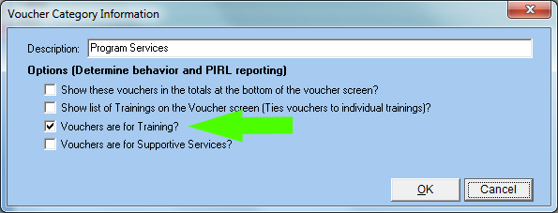
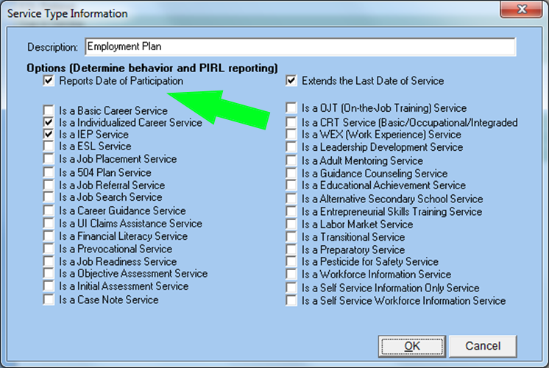
Determining the “Date of Participation” & Configuring AVP
Date of Participation
Under WIA, the first date after enrollment, other than the case note, set the date of participation. This was the same until November the 1st.
According to Laura Ibanez, it is now the IEP(Employment Plan).
For Direct Placements, you can do an “Employment Plan” then place in employment.
This will make the enrollee a “Participant”
AVP Calculates the Date of Participation by using the first Service Date where the service type has “Reports Date of Participation” checked on the service type info screen.
OR
The first Voucher Date that has “Vouchers are for Training” checked on it’s voucher category

Slide 5
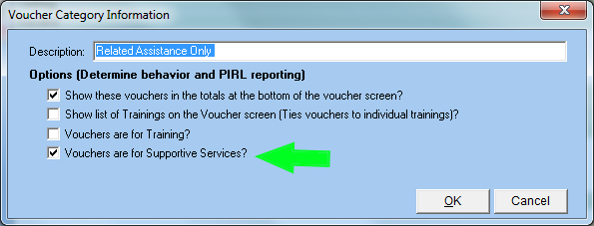
Determining the “Date of First Related Assistance Service” and how to configure AVP correctly
Voucher Categories need setup
RA Only is calculated by the first voucher that has “Vouchers are for Supportive Services” checked on the Voucher Category
OR
IF your system is configured to have “Related Assistance Services” in your Service Tab and you have no Voucher Tab, then the first Date of Service for any of these Related Assistance Services under the Services tab will be used in place of the vouchers.

Slide 6
How to Calculate Section B.5 (Reportable Individuals) in the QNR (WIOA Plan vs Actual) .
Previous instructions said only to report Exitors in the Reportable Individual section B.5 of the QNR.
We no longer report an exit date for reportable individuals.
To show the work that is being done in the field, I propose that we count ALL Reportable Individuals cumulatively for the program year.
With the pending update, we are not using the exit for B.5.
We need to determine today how to calculate this.
Carry Overs + New Participants + Reportable Individuals = Total Participants Served
If an Enrollee is an RA Only in the 1st quarter
In the 2nd quarter they receive an IEP and become a Participant.
They will move out of Section B.5 and into Participants for the 2nd quarter reports.

Slide 7
What about your Plan
I expect your Plan was sent in without knowing that RA Onlys would not count in New Participants.
Discussion on how to modify your plan to reflect the new definitions of;
Participants
Reportable Individuals (RA Only)

Slide 8
Export PIRL waits 6 months to report follow up data.
This allows your data to be reported at the same time that the federal UI wage data becomes available.
It gives you an extra 6 months time to find income.
AVP automatically waits 6 months to report this data in the PIRL

Slide 9
Measurable Skills Gains Reporting
MSG – Element 1811 is used for the dividend for MSG performance calculations.
Should we wait until their has been a chance for a gain to report this element?
Example: If someone starts training on October 30, there has been no time for a gain when reporting the 1st quarter. If we report element 1811, they will be a negative, so I would like to discuss waiting until the training is completed.
What if you waited until the training ends or a session ends to;
Retest
Report Element 1811
Report if there is a gain
This makes more sense to me if the performance measure is to determine how many of your trainees are achieving a gain.

Slide 10
Progress towards submitting the reports due for 1st quarter, PY 2017.
We have successfully tested a large test file with the WIPS system.
I then sent the file to Andrew, and it has further logical checks/errors.
This is difficult because;
If we change it for Andrew, then the WIPS may reject it.
We now have to be in compliance with 2 separate systems.
I have a call with Andrew this afternoon to work on solving these. Either in AVP, or in SPR’s system if applicable.

Slide 11
Suggested Logical Checks from SPR
When you submit to SPR, you will receive;
A Error List Report
A Suggested Error List Report
The “Suggested” error list has not been implemented in the PIRL, so you should ignore these until they are accepted and implemented in the PIRL.
If we implement them;
The WIPS may reject the change

Slide 12
Thank You!
At FosTech We;
Thank everyone for the faith you have placed in us.
Strive to continue to enhance AVP to implement all of WIOA
Appreciate all of the input we are getting from these webinars

