Slide 1
Welcomes To the FIRST
Agency View-Point NFJP Users Forum
WIOA Collaboration Webinar

Slide 2
Agencies that Utilize Agency View-Point for their NFJP Program
Arkansas Human Development Corporation
New England Farmworkers (Connecticut, Massachusetts & New Hampshire)
Illinois Migrant Council
ORO Development Corporation - Oklahoma
Mississippi Delta Council
O.I.C. of Washington – Washington State
Rocky Mountain SER - Colorado
Rural Employment Opportunities - Montana
Community Council of Idaho
Black Hills Special Services Cooperative - South Dakota
Project PPEP – Arizona
Maui Economic Opportunities – Maui, Hawaii
AND NOW – Proteus Inc. (Iowa, Indiana & Nebraska)

Slide 3
Todays discussion topic is
AVP Users Side Meeting at the DARI Conference
Quarterly Progress Reporting Process and particularly the Calculation of the Narrative PSS Numbers.
Are the Cumulative? Our thought is yes.
The current report calculate just like the instructions which are not necessarily cumulative.
We are working on a PSS Cumulative Quarters Plan vs Actuals Report.

Slide 4
Todays discussion topic is
Cumulative Quarters PSS Plan vs Actuals Report
We can calculate the Plan vs Actuals, but there are questions for todays discussion.
AVP is a Real-Time system.
Due to the 90Day Rule as Participants Exit Prior Quarter Numbers will Change;
Total Current Participant (END OF PERIOD) will decrease by 1.
Total Participants Exiting Program will increase by 1.
How does this effect your reporting?

Slide 5
Next Time
Topic Ideas
RA Only – Staff Assisted versus Non-Staff Assisted
Youth as Placements
Please email to kyle@fostechsolutions.com what you would like discussed within 2 days of the next webinar.
Date: 2 weeks from today? June 2, 2017 (3pm?)

Slide 6
Thank You!
At FosTech We;
Want to thank everyone for the faith you have placed in us.
Strive to continue to enhance AVP
Succeed with NFJP

Slide 7
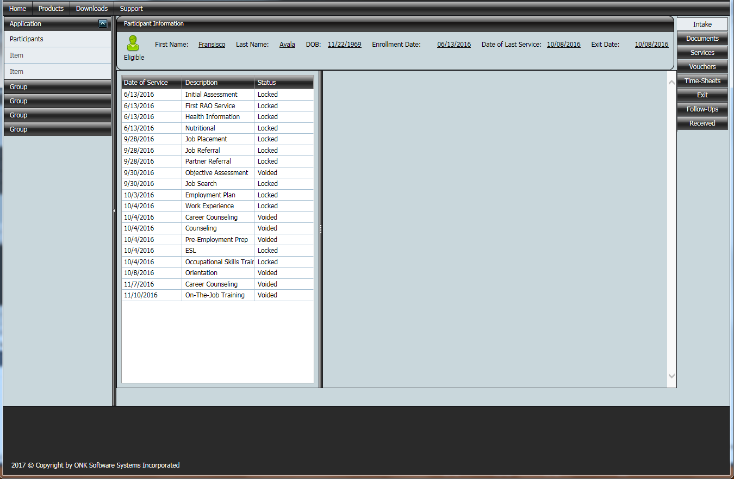
Agency View-Point Cloud – Sneak Peak at the Case File

