Slide 1
Welcomes to Today’s
Agency View-Point NFJP Users Forum
WIOA Collaboration Webinar

Slide 2
Today’s Topics
WIOA Plans Cumulate Automatically
Preparing for the WIPS Quarterly Submission
Youth Placement 2nd & 4th Quarter After Placements
Service Type Setup
Basic Career Services
Individualized Career Services
Better data now that we have the logic checks
Should you re-upload the 1st, 2nd and 3rd submission.
Working together to have DOL update within a time frame to give us time to implement and you time to enter accurate data.

Slide 3
Youth Placement 2nd & 4th Quarter After Placements
For those Enrolled as Youth on the Intake. Type of Placement on top of the Job Placement

Slide 4
Todays discussion topics
Panel on the bottom of the Follow Up will turn red as the time elapses

Slide 5
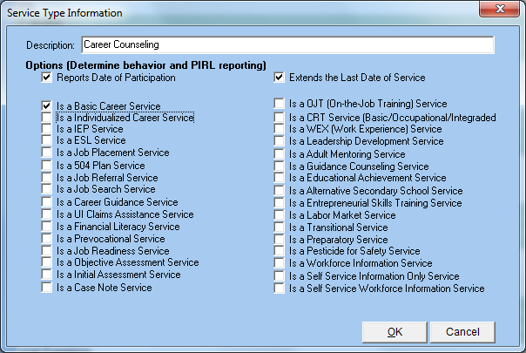
Service Type Setup Basic Career Services Individualized Career Services

Slide 6
Today’s Topics
Better data now that we have the logic checks
The new logic checks allow you to clean up your data since July 1, 2016
Follow Up Overrides may not have been reported correctly
Uploading Better Data
I would first upload the 4th Quarter on time.
If I had;
a lot of new Logical Check Errors
Been using the Override on the Follow Up Screen
I would then re-upload quarters 1 through 3

Slide 7
Today’s Topics
Working together to have DOL update within a time frame to give us time to implement and you time to enter accurate data.
DOL WIPS Team Released 10 days prior to submission period.
This gives us little if no time to implement the changes
You then have to correct your data
We may have to go through this iteration multiple times
If DOL wants Accurate Data, them updating so close to a submission desreases the chance of you uploading accurate data.
DOL is hurting its chance of getting good, clean accurate data.
The more agencies that bring this up to DOL, the better chance we have of being heard.

Slide 8
Thank You!
At FosTech We;
Thank everyone for the faith you have placed in us.
Strive to continue to enhance AVP to implement all of WIOA
Appreciate all of the input we are getting from these webinars

